Slide 1
RakthDaan
Presented By:-
1. SAIFUL ISLAM
2. ARUNAV CHETIA

Slide 2

General Problem
Estimated our country has a blood deficit of between 30% and 35% every year. In a land of 1.2 billion people it's ridiculous to say we can't meet the requirement.
"The problem is not insufficient number of donors, but finding a willing donor at the right time.
If someone needs blood, first - his family members - nearest hospitals and blood banks.
If they cannot manage blood in these ways - really hard for them to contact people to collect blood in a short span of time.

Slide 3
Real World Problem
Social media -”Urgently need X blood group”
Increase in accident victims - high amount of loss in blood - “Blood Bank / Hospital crrently out of blood stock”
Blood transfusion - “Needs High amount of blood”
Blood is not Artificial - Find Donor - Loss Time - chance the victim is out of time.
So there should be a portal for all the eligible donors whom on cases can be contacted

Slide 4
Solution is RaktDaaan App
Blood is precious gift - Gift of life
A simple pint can save three lives, a single gesture can create millions smiles

Slide 5
Solution
Focusing on building a network where people can help each other during an emergency.
What we aim for through this application, is that any person interested in donating blood can register himself as donor. Moreover if any consumer wants to make request to have blood online, he can also take the help of this application.
Instead of just providing people who need blood with an outdated list of regular donors who may or may not be available to help, Our application used to find rightfull person

Slide 6
About
Android application
Finding available blood donors around the locality without wandering here and there.
We designed this application for android users to use it convieniently and offcourse it's easy to operate.
For the donors we assured you the donors will be fully verified by our medical experts.

Slide 7
Objective
To find easily the nearby donors.
Save time in wandering
The main objective of this app is to improve the communication between donors and receivers/ consumers.

Slide 8
Technology used to Design Our Application
Android Studio
Java
XML
Firebase

Slide 9
System Requirements
Android OS
Android 4.4+
RAM 512GB
Space on Disk >10MB
Active connection is must

Slide 10
RaktDaan or Old fashioned
Forwarding messages
Calling numerous people
Visting or Contacting Blood Blood Banks/Hospitals

Slide 11
Future Directions
RaktDaaan v2.0
Interactive
One to One chat and voice functions
Location of donors real time
Realtime request for receiving or donoting
Adding sections for Blood Banks and Hospitals

Slide 12
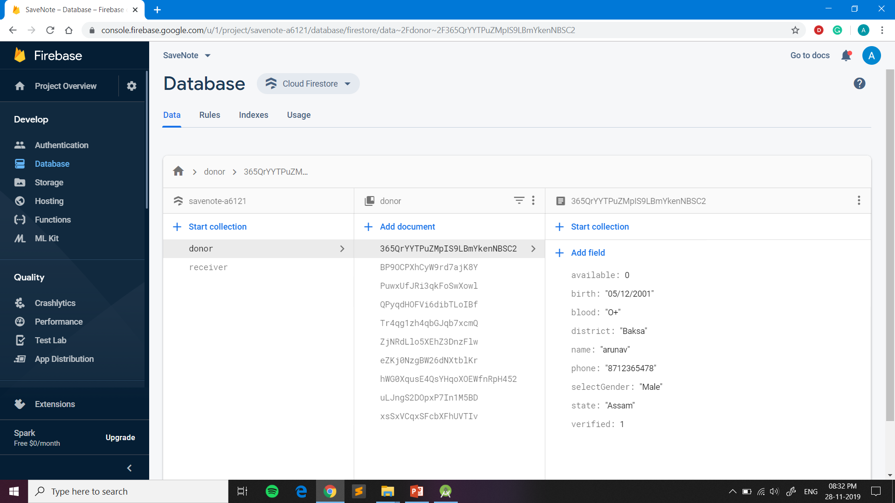
Database

Slide 13
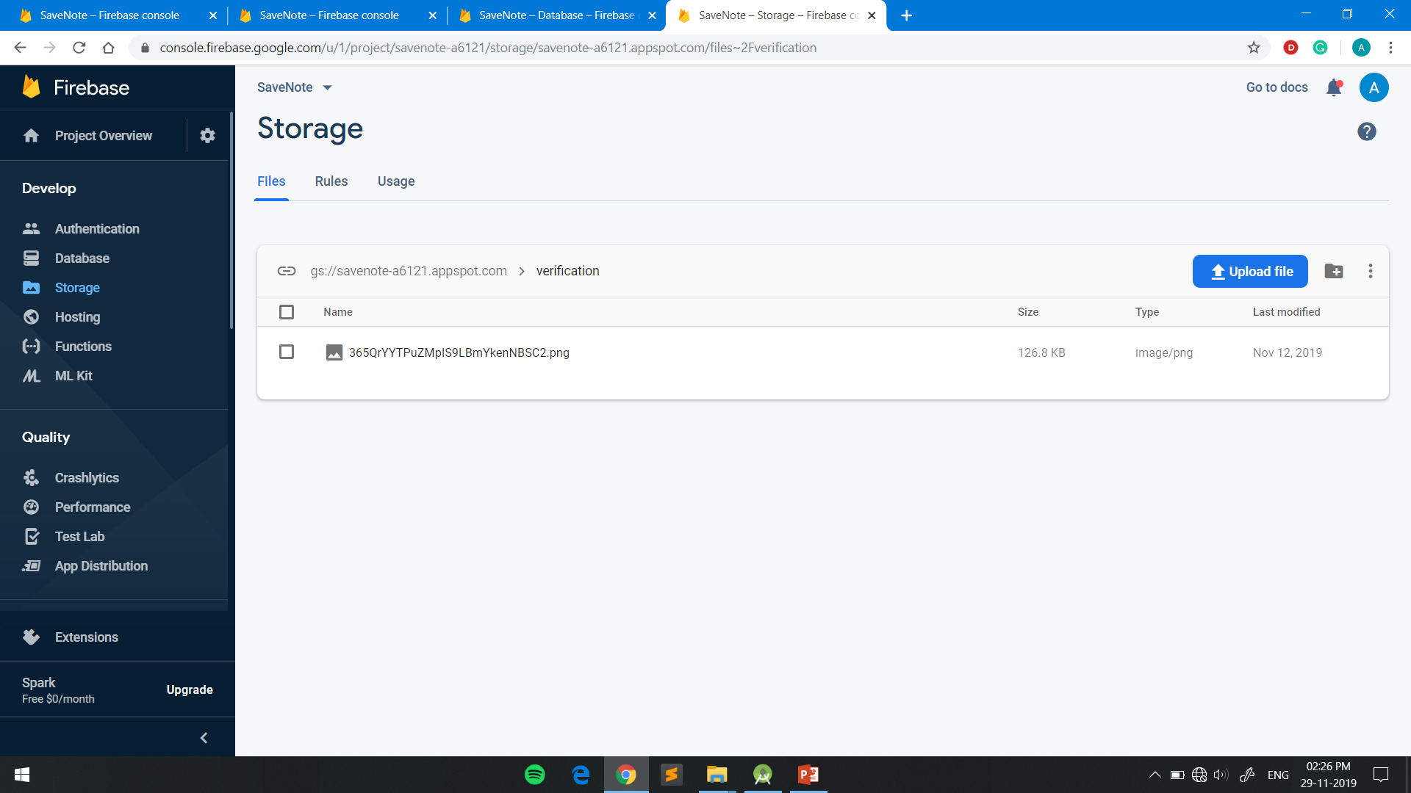
Database

Slide 14
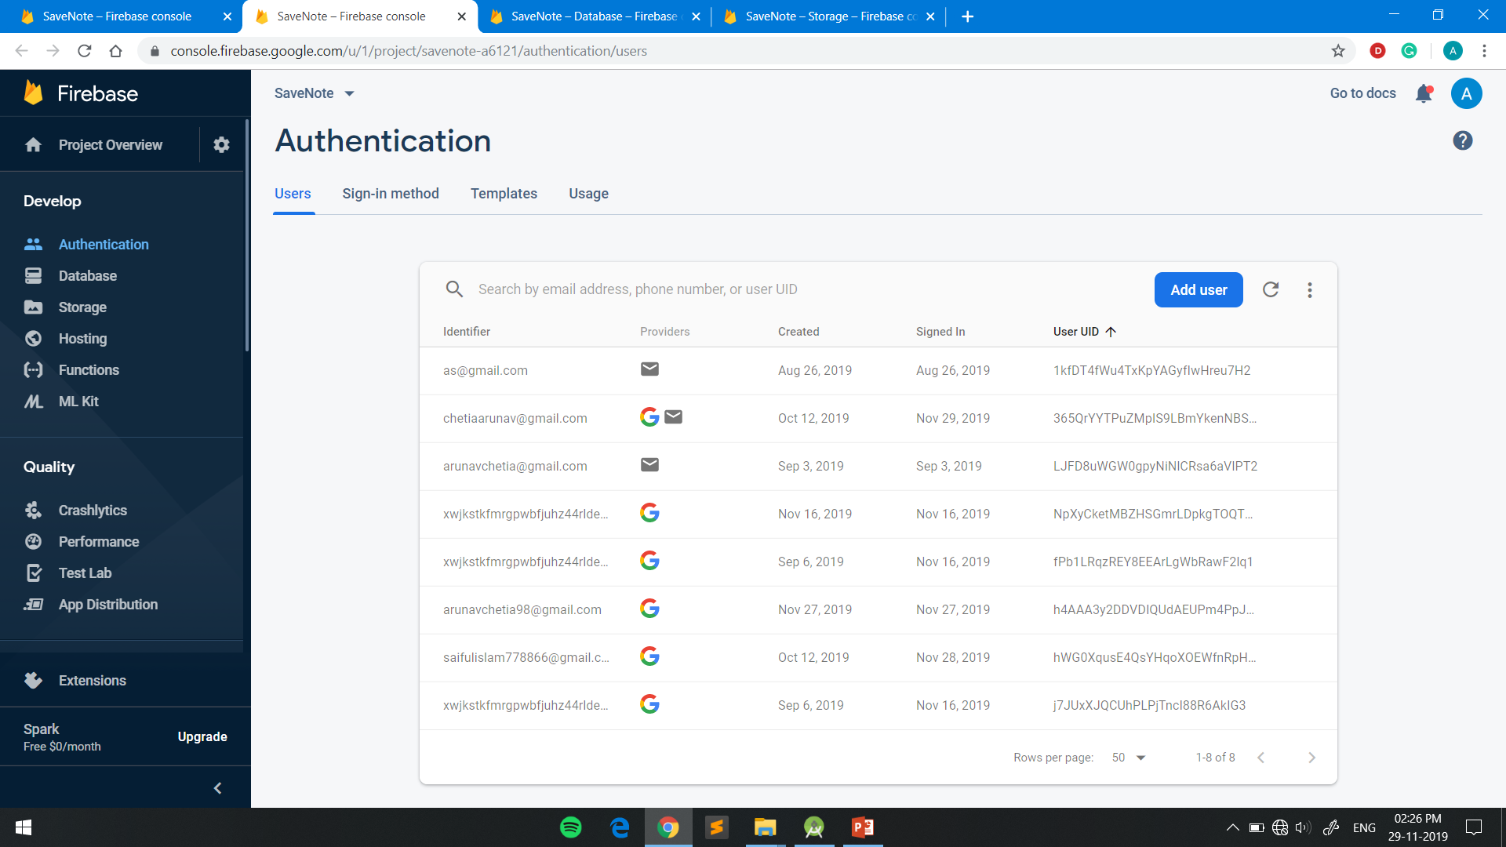
Database

Slide 15
Conclusion
With this application we hope that we can save atleast 100 lives by provding them blood on time.
The android application for blood donation can be used by a lot of people and will help a lot of different communities
The user can be a blood donor as well as a recipient.
The goal of the application is to provide solution to the existing deficit of blood and will connect the donors and the receivers who need blood.
This application will solve the current problem that the world is facing, and hence save a lot of lives.
This is the solution that we have for the existing problem

Slide 16
THANK YOU
~~~~~~Application Demo~~~~~~~

